Slide 1

B.V.V.S SHRI S.R.KANTHI ARTS,COMMERCE AND SCIENCE COLLEGE MUDHOL- 587313
Department of Physics
HEARTY WELCOME TO NAAC PEER TEAM:

Slide 2
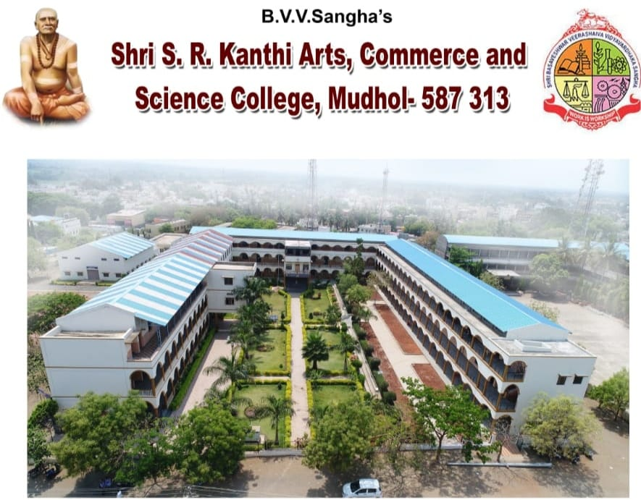
NOT EVERYONE NATURALLY ATTRACTED TO PHYSICS
If you’re naturally attracted to Physics ,you should feel that you are one of those few, selected by the Universe to understand the Universe from close.
Department of Physics has been started at the time of inception of the college in the year 1992.

Slide 3
COURSES:
Physics subject are taught as one of the optional subject at UG level.
Physics subject are taught as Discipline core and Discipline Elective subject in NEP.
The Subject Combinations available are as follows:
Department of Physics runs Value Added Course
i.e. Regulated Power Supply ,Basic Electronics, Fundamentals of Physics
CBCS | NEP
PCM,PMCs | PM,PC,PCs

Slide 4
Faculty Profile
Prof. A.V.Pattar [ M.Sc Mphil]
HoD of Physics
Prof Smt S.B.Meti [ M.Sc Mphil]
Prof Anil .Lamani [M.Sc BEd ]

Slide 5
Vision
In 2024 Physics Study Program will become an excellent and reputable study program in education, research and applied physics development
MISSON
To prepare students with good moral ,ethical and national –minded with strong knowledge in the field of Science and Physics Applications to produce competitive graduates
To be Actively involved in the community problem solving by utilizing physics in the developing of science and technology

Slide 6
Program Educational Objectives:
To impact quality of education in physics to students so as they become globally competitive physicist
To make the students to accept the challenges in Physics
Improve the student skills
To create strong interest in Physics, So as students can further develop themselves through self-study

Slide 7
Bridge Courses:
Bridge Couse is conducted for BSc I Semester students during the first week of the commencement of the course
Unitization Of Syllabus/Teaching Schedule
Month wise and teacher wise conspectus for classroom teaching for each semester is prepared by department
All the teachers have maintained work dairy and student’s register dairy
Review meetings conducted every month

Slide 8
Year wise strength & gender equality Students
Year | Class/ Sem | No . of Students | Enrolled |  | Pass%
 |  |  | Male | Female
2018-19 | BSc-I | 100 | 21 | 79 | 80
 | BSc-II | 53 | 13 | 40 | 79
 | BSc-III | 45 | 12 | 33 | 80
2019-20 | BSc-I | 136 | 40 | 96 | 73
 | BSc-II | 93 | 15 | 78 | 84
 | BSc-III | 46 | 16 | 30 | 78
2020-21 | BSc-I | 111 | 21 | 90 | 100
 | BSc-II | 126 | 26 | 100 | 84
 | BSc-III | 89 | 39 | 50 | 84
2021-22 | BSc-I | 52 | 22 | 40 | 86
 | BSc-II | 92 | 30 | 62 | 92
 | BSc-III | 118 | 38 | 80 | 94

Slide 9
Year | Class/ Sem | No . of Students | Enrolled |  | Pass%
 |  |  | Male | Female
2022-23 | BSc-I | 25 | 04 | 21 | 75
 | BSc-II | 54 | 14 | 40 | 95
 | BSc-III | 90 | 20 | 70 | 90
2023-24 | BSc-I | 38 | 08 | 30 | 89
 | BSc-II | 24 | 04 | 20 | 86
 | BSc-III | 48 | 09 | 39 | 89

Slide 11
Year wise strength and gender equality Students
Year | 2018-19 | 2019-20 | 2020-21 | 2021-22 | 2022-23 | 2023-24
Boys | 46 | 71 | 86 | 90 | 38 | 21
Girls | 152 | 204 | 240 | 182 | 131 | 89
Total Strength | 198 | 275 | 326 | 272 | 169 | 110

Slide 12
Socio-Economic Profile of Physics Students
Year | Class/ Sem | No . of Students | Category
 |  |  | SC | ST | OBC | GM
2018-19 | BSc-I | 100 | 20 | 24 | 37 | 19
 | BSc-II | 53 | 22 | 08 | 20 | 3
 | BSc-III | 45 | 18 | 10 | 12 | 05
2019-20 | BSc-I | 136 | 48 | 37 | 30 | 21
 | BSc-II | 93 | 41 | 28 | 21 | 03
 | BSc-III | 46 | 15 | 14 | 09 | 08
2020-21 | BSc-I | 111 | 47 | 31 | 18 | 15
 | BSc-II | 126 | 41 | 38 | 37 | 10
 | BSc-III | 89 | 31 | 20 | 28 | 10
2021-22 | BSc-I | 52 | 20 | 08 | 13 | 11
 | BSc-II | 92 | 40 | 28 | 15 | 09
 | BSc-III | 118 | 49 | 38 | 20 | 11

Slide 13
Year | Class/ Sem | No . of Students | Category
 |  |  | SC | ST | OBC | GM
2022-23 | BSc-I | 25 | 12 | 08 | 05 | -
 | BSc-II | 54 | 30 | 12 | 07 | 05
 | BSc-III | 90 | 31 | 37 | 14 | 8
2023-24 | BSc-I | 38 | 12 | 10 | 10 | 06
 | BSc-II | 24 | 07 | 10 | 03 | 04
 | BSc-III | 48 | 20 | 12 | 08 | 08

Slide 14
Advanced Learners & Slow Learners
Policies to identify the Advanced learners/slow learners
Previous semester/exam results
Class tests
Advanced Learners
Advanced leaners are encouraged to give seminars , to take up project work
ICT enabled seminars & presentation are given
Students are encouraged to participate in Science congress ,National Level Seminars

Slide 15
Remedial For Slow Leaners
Remedial Coaching
Providing the Extra Books
Different teaching methods
Counselling
Outcomes of Advanced Learners
The Strategies employed for slow learners helped them to clear exams

Slide 16
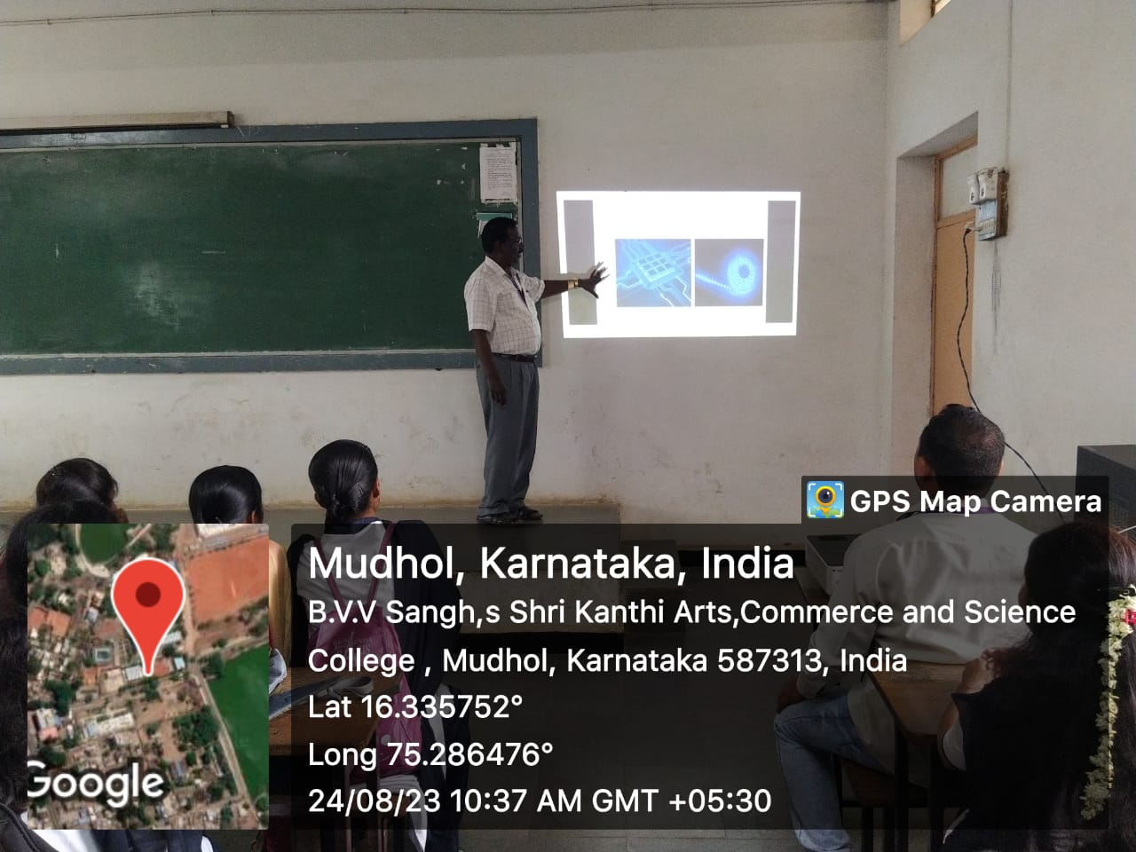
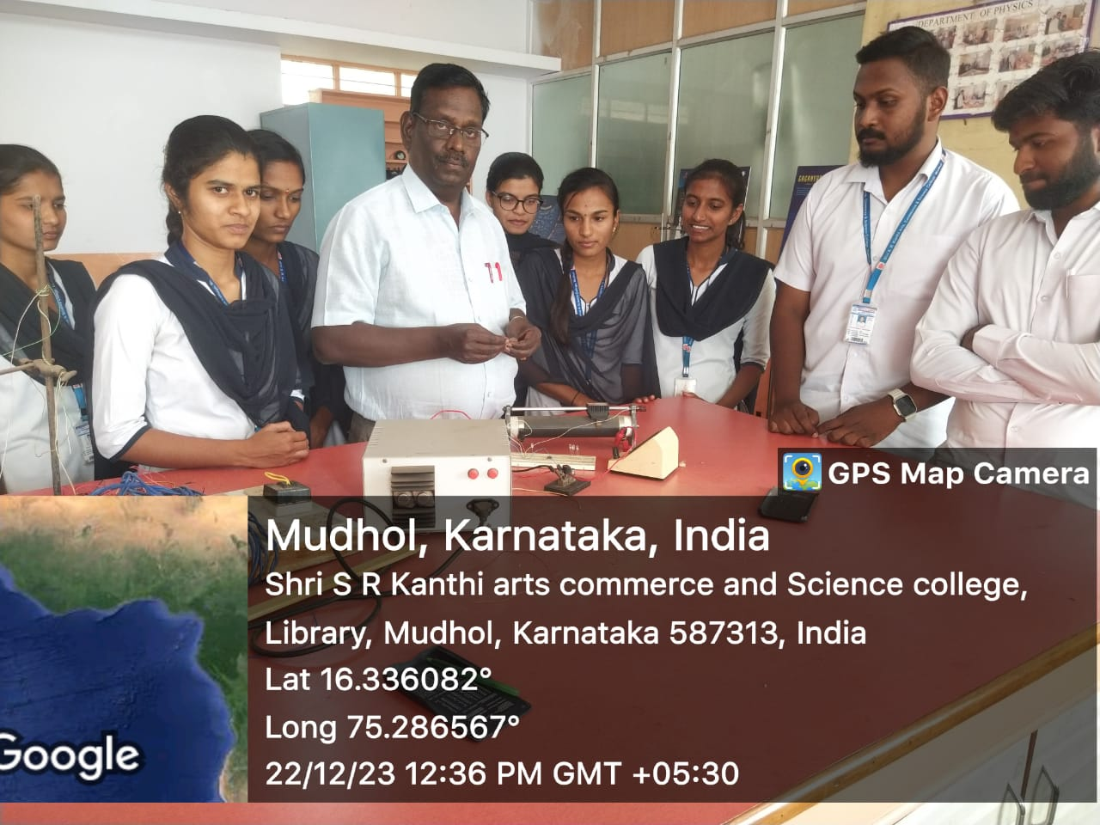
Teaching & Learning Methods in Physics
Student Seminars
Exhibition
Carrier Oriented Training

Slide 17




ICT Tools Used in Physics
 | VIEW
 | VIEW
 | VIEW
 | VIEW

Slide 18
Course Outcomes
Program Outcomes
PO1:Demonstrate, solve and an understanding of major concepts in all disciplines of Physics.
PO2:Create an awareness of the impact of Physics on the society and development outside the scientific community.
PSO1: Acquiring the fundamental knowledge : Gain the knowledge of Physics through Theory & Practical’s
PSO2:Development of laboratory skills :Understand good laboratory practices, safety, make aware & handle sophisticated instruments/ equipment

Slide 19
Result Analysis Of Physics
Year | Class | Total Strength | Distinction | I Class | II Class | Pass | Total Pass | Percentage
2018-19 | BSc-III | 45 | 15 | 16 | 08 | 01 | 40 | 88.8
2019-20 | BSc-III | 46 | 28 | 8 | 08 | - | 44 | 95.6
2020-21 | BSc-III | 89 | 37 | 20 | 10 | 15 | 82 | 92
2021-22 | BSc-III | 118 | 53 | 38 | 20 | 02 | 113 | 95
2022-23 | BSc-III | 90 | 28 | 20 | 24 | 08 | 84 | 93
2023-24 | BSc-III | 48 | 15 | 15 | 08 | 05 | 46 | 95.8
Average Pass Percentage |  |  |  |  |  |  |  | 93.45%

Slide 21
Classroom Seminars
Year | seminars
2018-19 | 30
2019-20 | 8
2020-21 | 9
2021-22 | 20
2022-23 | 21
2023-24 | 28
total | 116

Slide 22
LEARNING RESOURCES
RESOURCES | Total No. of Physics Books
Central Library | 988
Department Library | 42

Slide 23
SEMINARS / WORKSHOPS ATTENDED
SI.NO | Name of the Faculty | Workshops
1 | Prof A .V. Pattar | O8
2 | Prof Smt S .B. Meti | 02
3 | Prof Anil Lamani | 02

Slide 24
RESOURCE PERSON
Name | Event | Organized Institute | Year
Prof A.V.Pattar | Chaired : A Technical session in seminar | B.R.C ( Block Resource Cener) | 2017 & 2021
 | online | R.P.S High School Lokapur | 2020-21 & 2022-23

Slide 25
OTHER RESPONSIBILITIES
Sl No | Role | Year
1. | Science Forum- Chairman | 2013 Onwards
2 | Shri Kalika Devi Sameeti | Life member
3 | Criteria V MEMBER | 2018- 2024

Slide 26
PHYSICS TOPPERS
Sl No | Name of the Student | Marks scored ( Out of 100 )
1 | Basayya Matapathi | 100
2 | Gopal Sandrimani | 100
3 | Aishwarya Gavimath | 99
4 | Anupama Jogi | 97

Slide 27
PHYSICS TOPPERS
Year | Name | Semester | Marks
2018-19 | Ashwini Modi | IV | 96
 | Vijaylaxmi Mugalkod | IV | 93
 | Ashwini Halgatti | V | 92
2019-20 | SaiyadSabha Mamdapur | I | 96
 | Afreen Batkurki | I | 92
2020-21 | Vijaylaxmi Malpagol | I | 92
 | Prashant Maddepagol | I | 93
 | Pooja Bandivaddar | I | 90
 | SaiyadSabha Mamdapur | III | 96
 | Mutturaj Palled | III | 90
 | Akshata dali | III | 90
 | Daneshwari Kolkar | V | 90
 | Saniya Bhistipakhali | V | 90
 | Pooja Aloor | VI | 96
 | Akkamma Julpi | VI | 90

Slide 28
Year | Name | Semester | Marks
2021-22 | Aishwaraya Kittur | II | 96
 | Aishwarya Ingale | II | 92
 | Annapurna Pattar | II | 91
 | Divya Sattigeri | II | 91
 | Laxmi Badiger | II | 90
 | Laxmi Kadakol | II | 90
 | Aishwarya Wali | IV | 94
 | Akash Mekkalaki | IV | 93
 | Ashwini Modi | VI | 96
 | Akash Rayappa | VI | 92
 | Mutturaj S. Palled | VI | 91
2022-23 | Aishwarya Kitturu | II | 90
 | Aishwarya Ingale | II | 90
 | Annapurna Pattar | II | 89
 | Divya Sattigeri | II | 88

Slide 29
Year | Name | Semester | Marks
2023-24 | Aishwarya Ingale | V | 91
 | Vijaylaxmi H.Athani | V | 94
 | Goun Totad | V | 97
 | Aishwarya Kittur | V | 97
 | Laxmi Gennur | V | 94
 | Geeta Immadi | V | 90
 | Keerti Ganiger | V | 93
 | Mala Hanchinal | V | 95
 | Swathi S.Bhovi | V | 92

Slide 30
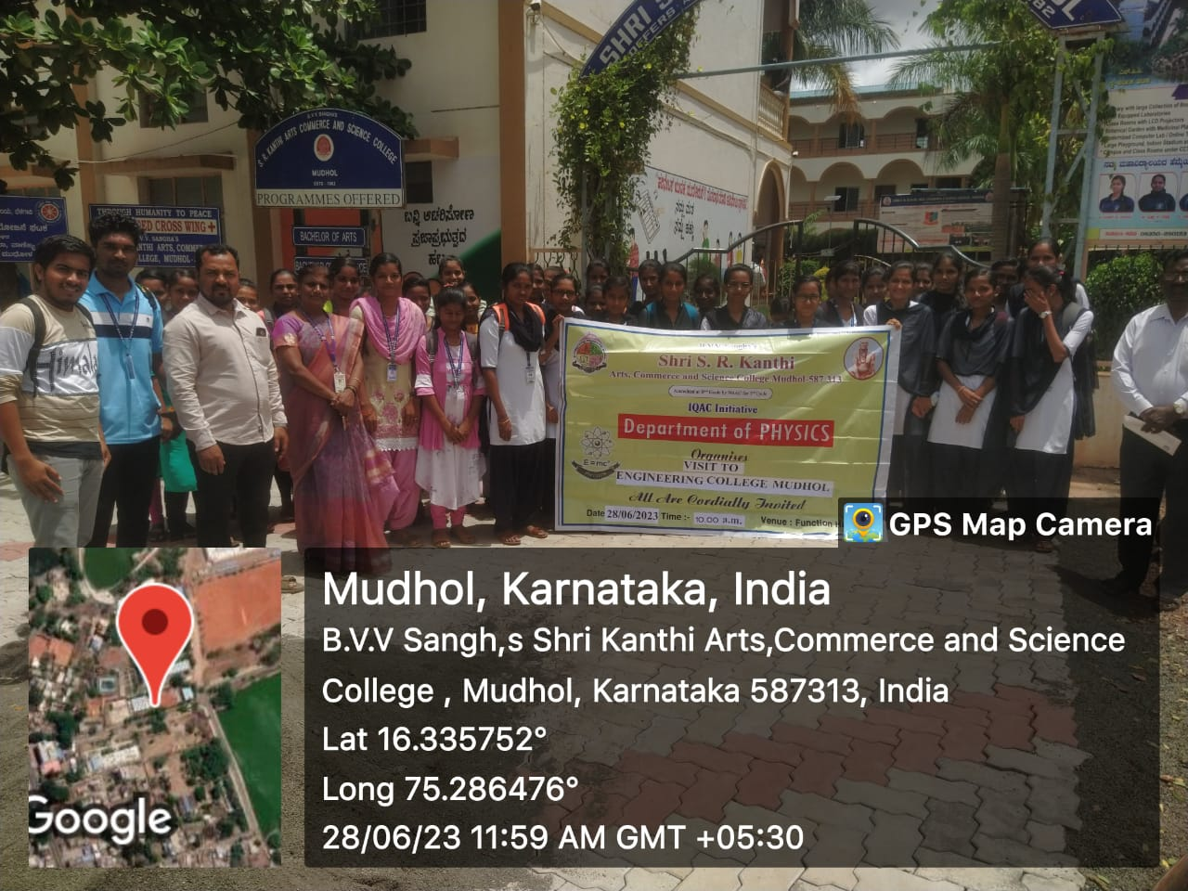
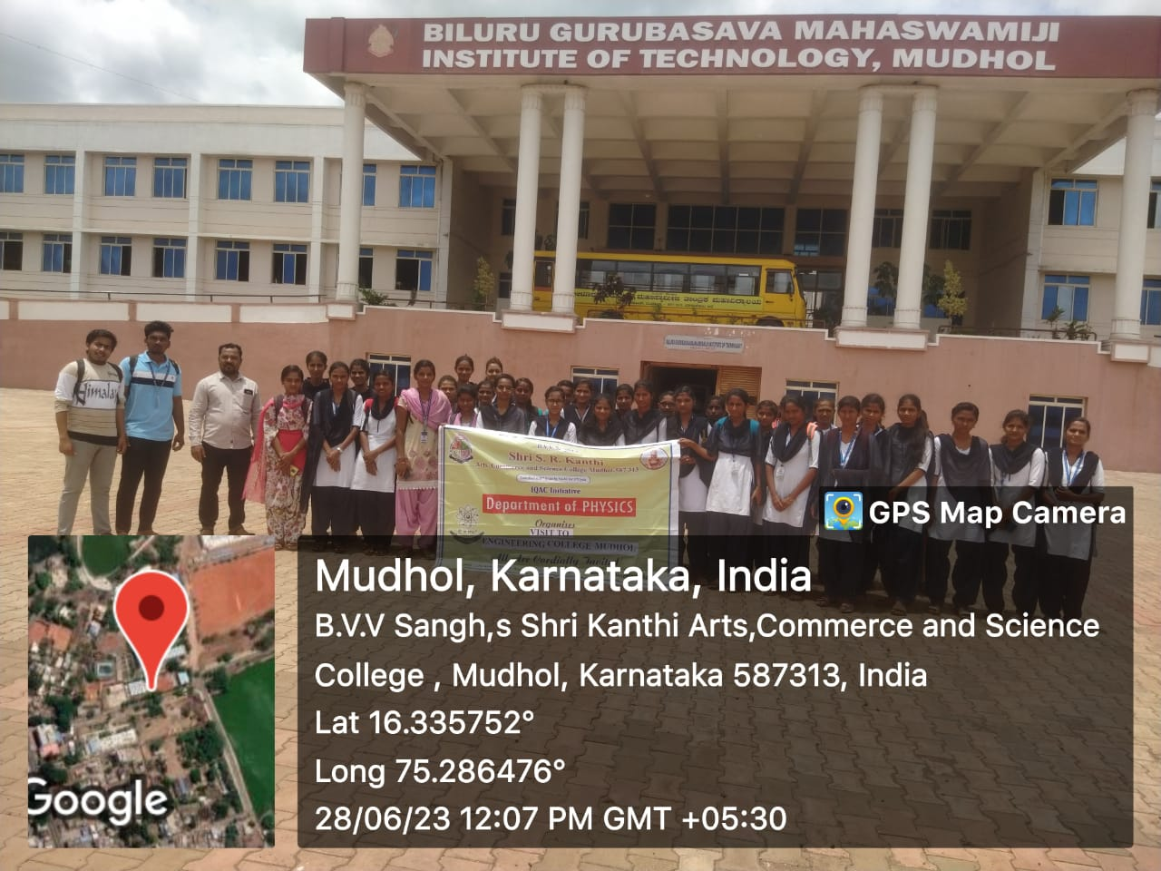
Departmental Activities
National Science Day is celebrated with different themes followed every year to acknowledge all the sectors in Science and technology in Feb 28th to commemorate the discovery of the Raman effect.
Webinar on: Recent developments in Nano technology

Slide 31
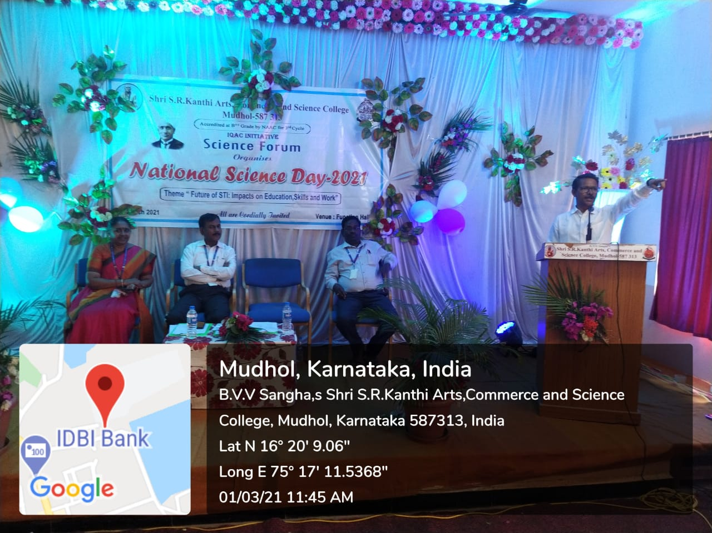
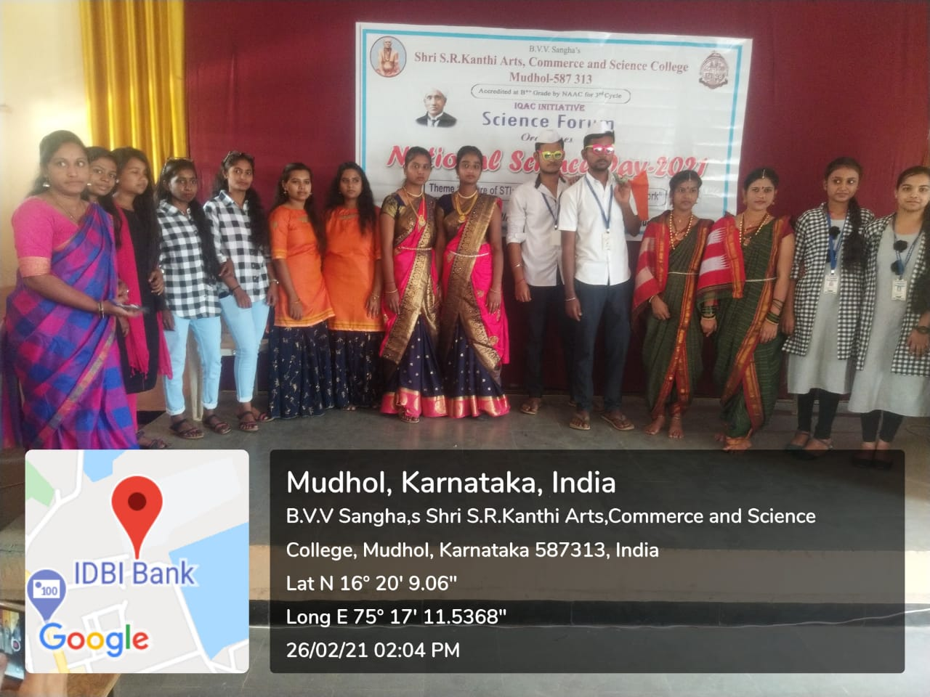
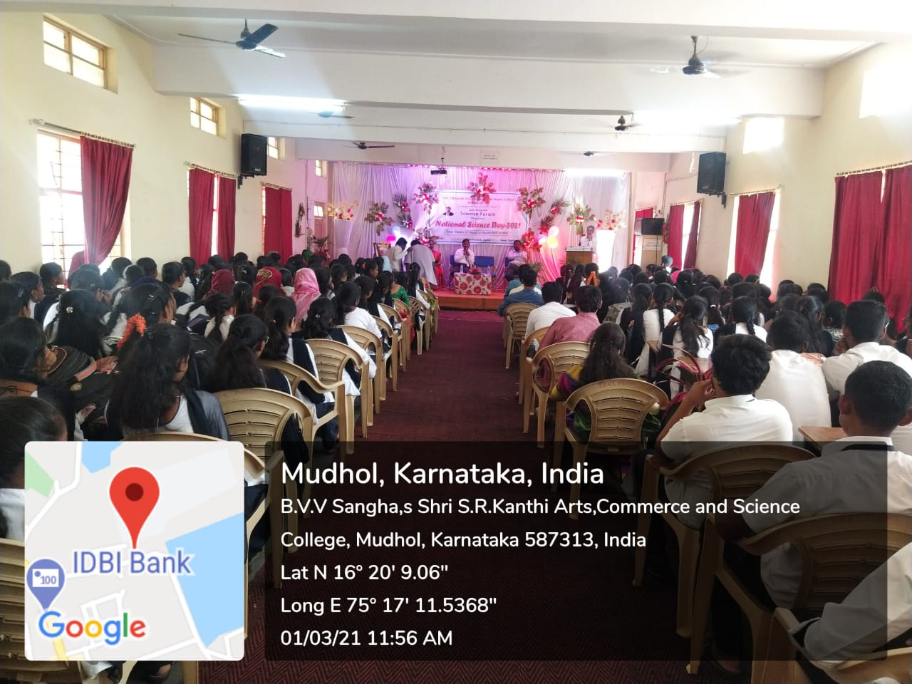
Best Practices
National Science Day is celebrated with different themes followed every year to acknowledge all the sectors in science & technology on February 28 to commemorate the discovery of the Raman Effect.
Department of Physics celebrates the NSD in the last week of February by calling it as Science week every year and arranges various competitions (Quiz, Essay, PPT & Poster Presentations)through out the Science week to the students.

Slide 32
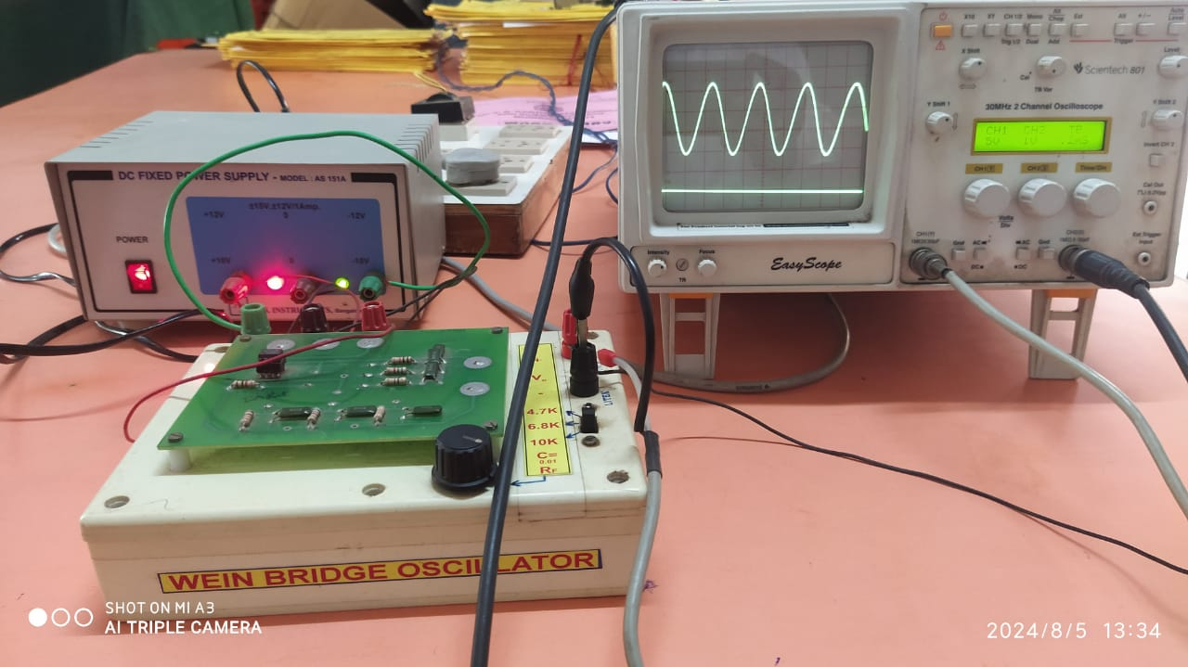
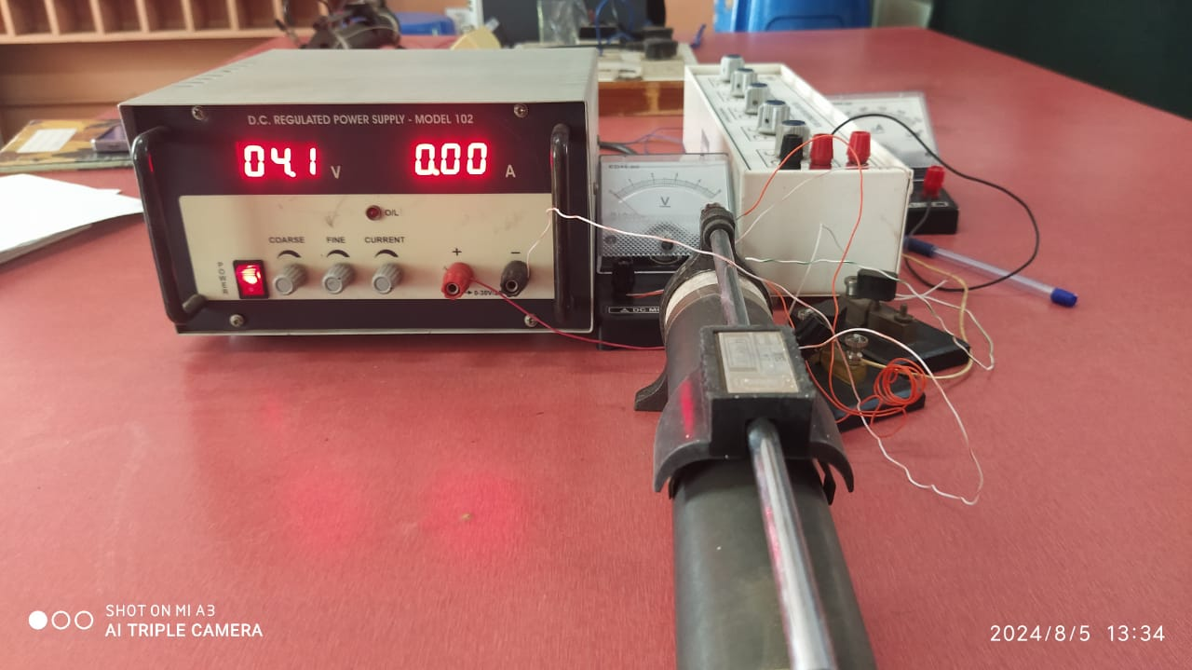
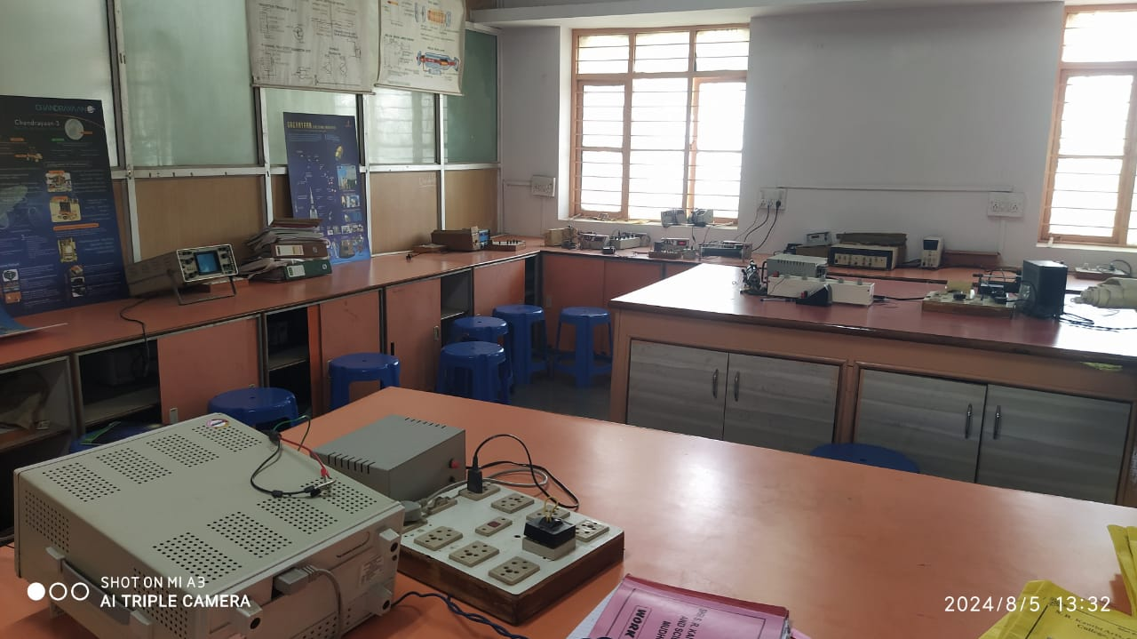
Notable Equipment
SI.NO | Equipment Name | Total
1 | Cathode Ray Oscilloscope | 06
2 | Signal Generator | 12
3 | AC mili Voltmeter | 06
4 | Spectrometer | 04
5 | Travelling Microscope | 05
6 | Moving Coil galvanometer | 08
7 | Laser kit | 02
8 | Decibel meter | 01
9 | LCD Projector | 01
10 | Optical Bench | 01
11 | Stabilizer | 01

Slide 33
Future Plan
Plan
Up gradation of laboratory
Implimentation of resource culture in the Department

Slide 34


